Slide 1
Welcome to Psychology
Ψ
In preparation for your A level course please read the following Powerpoint and complete the short tasks at the end.

Slide 2
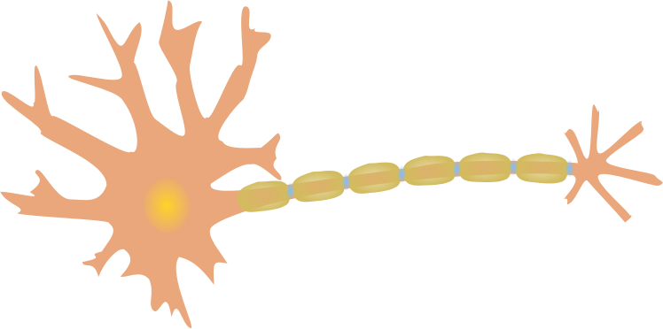
The word ‘science’
From the Latin
Scire
meaning ‘to know’
The subject matter of all science is the natural world. Knowledge of art, history or zombie films does not constitute science because these are not part of the natural world.

Slide 3
Science is about discovering truths
The purpose of psychology and other sciences is to discover truths. Scientists are as far as possible:
Empirical: This means that we observe evidence and judge that it indicates a fact is likely to be true
Objective: We see what is really there rather than what might be from a personal perspective

Slide 4
What makes psychology a science?
Psychology is a science because psychologists (mostly) are concerned with knowledge about human mind and behaviour.
The word ‘knowledge’ is crucial because psychologists try to avoid guessing, assuming and speculating about the mind, and instead carry out research in order to find out.
This emphasis on research makes psychology different from philosophy, psychoanalysis and common sense, all of which are also concerned with the human mind.

Slide 5
Is psychology a ‘good’ science?
There are very different views according to who you ask.
The public say psychology is just common sense (Lilienfield, 2012)
Other scientists and social scientists say we are a poor science because it is impossible to study people objectively
We say that we can apply scientific principles to studying people. We can try to be objective while accepting that this is difficult

Slide 6
Theories and paradigms
Scientists do not just observe events and record them. They also try to explain how and why they happen. An explanation of this kind is called a theory.
Science constantly develops as we develop new research methods and acquire more knowledge. The theories around in a science at any one time share some core ideas. These ideas and theories make up a paradigm.
When the core ideas in a science develop beyond a certain point the science undergoes a paradigm shift.

Slide 7
Theoretical perspectives on psychology
Is all psychology equally scientific?
BUT
Mainstream approaches to psychology, for example biopsychology, cognitive and experimental social psychology, tend to conform well to scientific principles.
There are more radical views within psychology.
Humanistic psychologists reject the scientific process, while social constructivists reject the whole idea of truths

Slide 8
Conclusions
Science is about discovering truths.
Scientists do this by carrying out empirical research.
As far as possible scientists maintain objectivity.
Psychology is a science because psychologists carry out empirical research while try to be objective.
Sciences, including psychology, construct theories to explain research findings.
Not all approaches to psychology embrace science, and more radical approaches reject it.

Slide 9
What is Psychology?
Ψ
Psyche is Greek meaning soul or mind and logia means a study or account. Psychology is therefore the study of the mind and behaviour.
Philosophy first
All the sciences evolved from Philosophy with a move towards empirical methods of investigation in order to gain more objective answers.
Today, Psychology professes to be a science, employing the scientific method but continuing to investigate subjects of Philosophical interest like the mind and consciousness.
Psychology departments in the USA often began as offshoots from Philosophy departments whereas in other places such as Germany, Psychology grew out of the science faculties.
Do you think Psychology should be in the science or humanities department?
Ψ

Slide 10
Is Psychology a science?
Ψ
Task 1:
Define these terms:
Empirical, Objective, Paradigm and Paradigm shift.
Task 2:
Read each of the studies on the next slide and write brief summaries of at least numbers 1-3, and 4-5 if you get time.
Task 3:
Watch any of the videos on the final slide that take your interest, if you get time.

Slide 11
Key studies
Ψ
1) https://simplypsychology.org/milgram.html - Milgram
2) https://www.simplypsychology.org/zimbardo.html - Zimbardo
3) https://www.simplypsychology.org/loftus-palmer.html - Loftus and Palmer
4) https://www.simplypsychology.org/mary-ainsworth.html - Ainsworth
5) http://www.holah.karoo.net/rainestudy.htm - Raine
These are each important studies in Psychology that you may come across throughout the course. Reading them and making notes will help to give you an insight into what the subject is like; some of them are quite bizarre!

Slide 12
Relevant videos
Ψ
https://www.ted.com/talks/petter_johansson_do_you_really_know_why_you_do_what_you_do
https://www.ted.com/talks/laurel_braitman_depressed_dogs_cats_with_ocd_what_animal_madness_means_for_us_humans
https://www.ted.com/talks/elizabeth_loftus_how_reliable_is_your_memory
https://www.ted.com/talks/philip_zimbardo_on_the_psychology_of_evil
https://www.ted.com/talks/steven_pinker_human_nature_and_the_blank_slate
https://www.youtube.com/watch?v=nJm7AhdGbDk (Sigmund Freud documentary – about an incredibly important figure in Psychology)

